Slide 1
Speech-to-Text Conversion
Written by Bálint Skach

Slide 2
Origin
Since the 1950s there have been experiments with voice recognition
The first one was capable to recognise around ten words from a single speaker
In the 1960s Dynamic Time Warping (DTW) algorithm made it possible to increase the vocabulary to 200 words
The first time it became available to the consumers was in the 1990s, when AT&T released their Voice Recognition Call Processing service

Slide 3
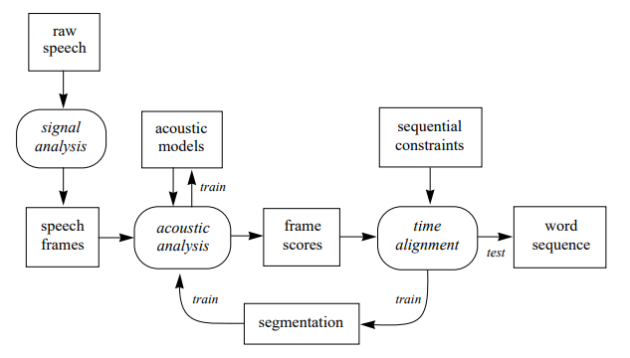
How does it work?
Source: Joe Tebelskis - Speech Recognition using Neural Networks, Figure 2.1: Structure of a standard speech recognition system.

Slide 4
How does it work?
To recognize voice, first we have to understand what voice is made of
From a top-down approach we have sentences
A sentence contains words
A word contains morphemes
Morphemes are the smallest unit of a language that has meaning
A morpheme contains phonemes
Phonemes are the smallest unit of sound
This is where we will start our recognition

Slide 5
Phonemes
The English language has about 44 phonemes, depending on the dialect
For example the word "cat" is made up of 3 phoneme
/c/ /a/ and /t/
These small sets of sounds are a good start, because they are easily recognisable
But the problem is that no one pronounces them the same way, even the same person can say it differently
This is why the Dynamic Time Warping algorithm was created

Slide 6
Dynamic Time Warping (DTW)
DTW uses words as its base
If we take our unknown sound that we want to recognize, and try to match it to a set of known samples, most of the time we would not get a decent result, because of the variances between our sample and our sample base.
To get over this problem, DTW proposes a solution, where we can normalize our unknown sound, change its phase and find the best fitting sample.
To achieve this, DTW uses a simple matrix calculation
C(x, y) = MIN (C (x – 1,y) , C (x – 1,y – 1) , C (x, y – 1) ) + D (x, y)
Where C(x,y) is the cumulative score along an optimal alignment path that leads to (x,y)
And D(x,y) is the Euclidean distance between frame x of the speech sample and frame y of the reference template

Slide 7
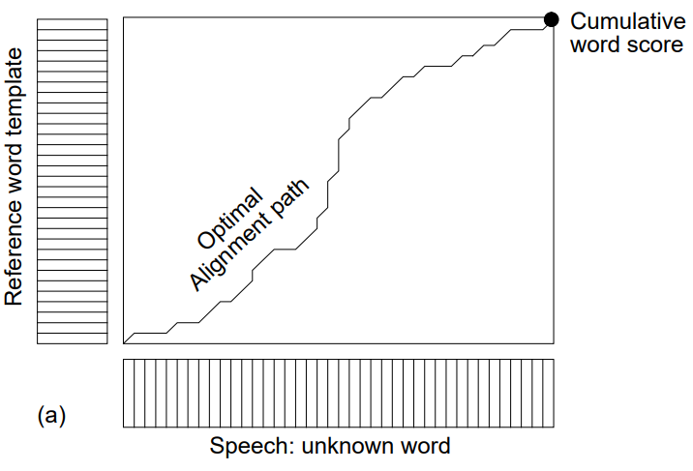
Dynamic Time Warping (DTW)
Source: Joe Tebelskis - Speech Recognition using Neural Networks, Figure 2.6

Slide 8
Hidden Markov Model (HMM)
HMM works on multiple layers of abstraction, consisting of states interpreted as acoustic models, and weights connecting the states, indicating the probability of how a state may follow another state in sequence
There are 3 kinds of algorithms associated with HMM:
Forward algorithm, for isolated word recognition
Viterbi algorithm, for continuous speech recognition
Forward-backward algorithm, for training the HMM

Slide 9
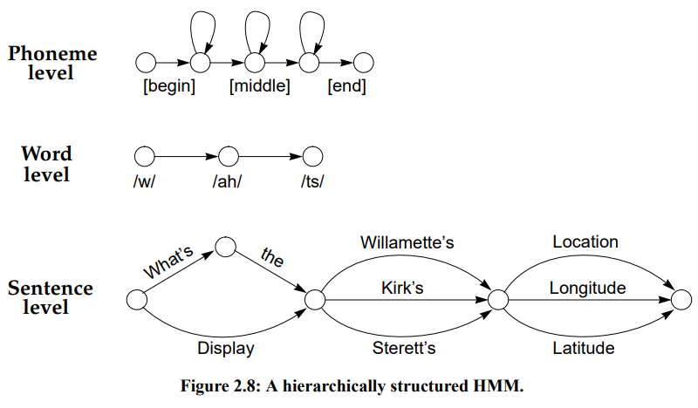
Hidden Markov Model (HMM)
Source: Joe Tebelskis - Speech Recognition using Neural Networks, Figure 2.8

Slide 10
Modern Voice Recognition
Today Voice Recognition can be found everywhere, mostly in a form of a Recurrent Neural Network – Hidden Markov Model hybrid.
Thanks to the "unlimited" computing power provided by the big cloud service providers (Google, Amazon, Azure), everyone can access these services

Slide 11
Speech-to-Text Microsoft.Speech library
If you want to, you can create your own Speech-to-Text application in about 10 lines of C# code
It will not be nearly as accurate as the free applications available on the internet
But for demonstration purposes I have created one
To be fair, I have not made any effort to calibrate it, so its true potential is still unknown to me

Slide 12
Demo Microsoft.Speech library

Slide 13
Free(mium) applications
https://speechnotes.co/
It uses Google's speech-to-text engine
There is a free version, and a single purchase version
https://dictation.io/speech
This one also uses Google's speech-to-text engine
Completly free
You can create your own application using the GCP speech-to-text engine
https://cloud.google.com/speech-to-text/
Free up to 60 minutes, after that 0.006 USD / 15 seconds
120 languages

Slide 14
Use cases
Personally I think Speech-to-Text is a very small subset of Voice Recognition, but there are still many use cases for it, for example:
Providing a way of communication for physically disabled people who can't use their hands, or for blind people
Transcribing meetings
Real time transcribing TV broadcasts
Translating spoken sentences (with the help of a translation service)
Anytime when your hands are not free to text someone (for example: driving)

Slide 15
Concept for an applicaton
We want to create an application that provides a way for Students to transcribe their lectures.
The application uses the Google Speech-to-Text engine.
The student is able to store and catalog the lectures on their device and also on Cloud Storage.

Slide 16
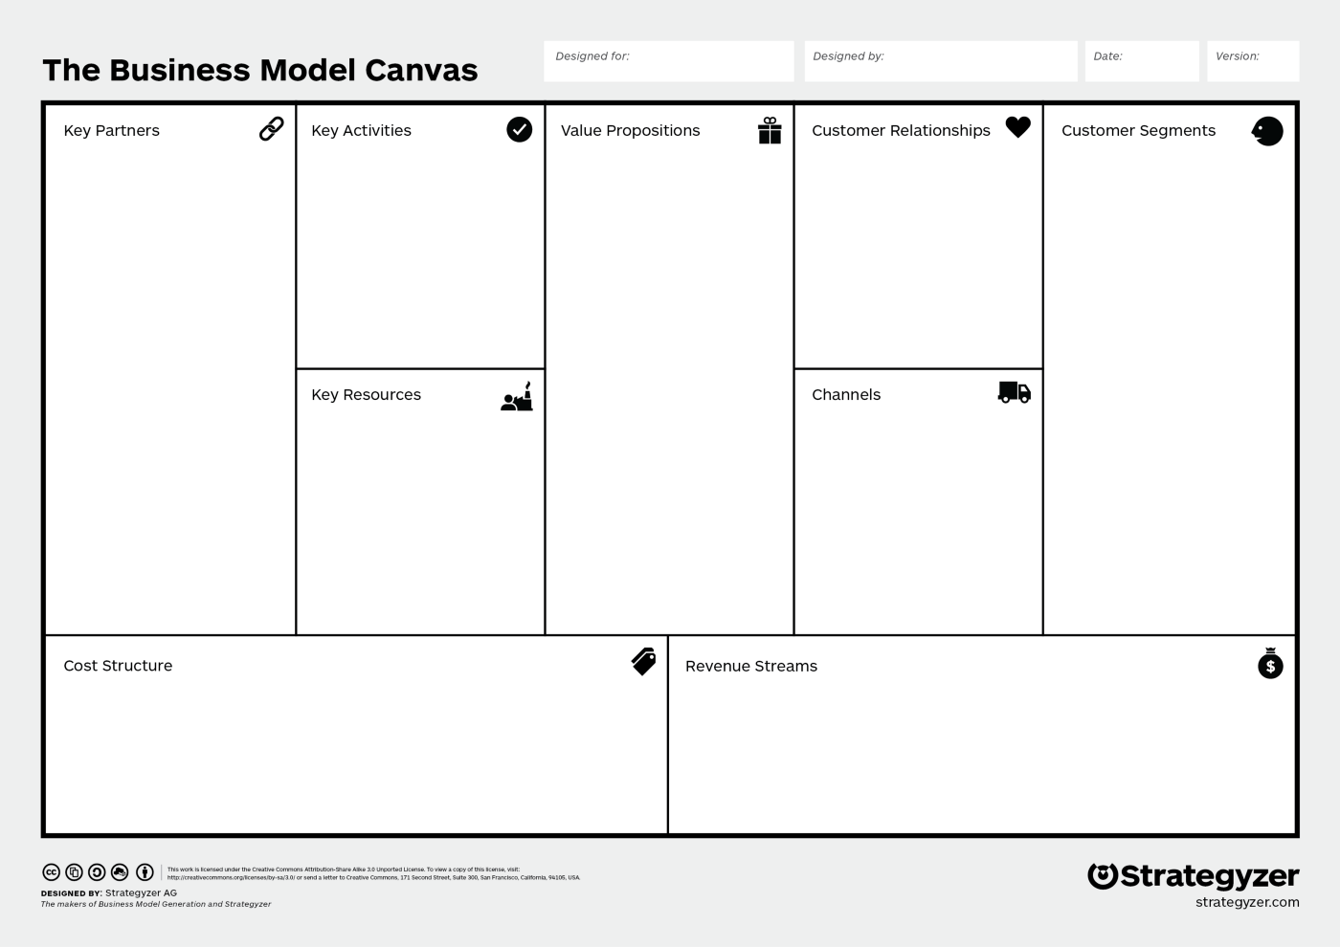
Provide a way for Students to transcribe their lectures in a seemless way
Google Cloud Platform
Students
Professors
Production
Marketing
Free support/
troubleshooting
Main characteristics:
Convenience
Accessibility
"Getting the job done"
-Servers for the application
-Developers
-Marketing team
-Customer support team
-Reach them through Social media
-On Campus advertisements
-Refer-a-friend, get 2 lecture transcribing free
Google related costs
- Linearly scales with usage
Employee salary
Dynamic payment:
-Per lecture based

Slide 17
Thank you for your attention!
Source:
Joe Tebelskis - Speech Recognition using Neural Networks

